Slide 1

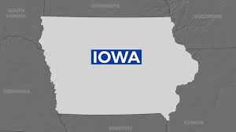
Iowa Vehicle Crash Data Analysis
Group Members: Sai Jeshwanth Goud, Balvanth Gowda, Goutham Senthil kumar, Saloni Kotnis, Rajat Jhawar

Slide 2
Problem Statement
Public Safety Issue in Iowa:
High number of vehicle crashes resulting in fatalities, injuries, and economic losses.
Primary Challenge:
Reduce the frequency and severity of crashes.
Approach to Address the Challenge:
Analyze crash data to identify patterns and risk factors.
Pinpoint high-risk locations.
Understand contributing factors to crashes.
Objective of the Project:
Leverage Big Data analytics.
Provide actionable insights for informed strategic decision-making.
Enhance road safety in Iowa.
MIS 515: Big Data for Business
Notes:
At Safe Routes Analytics, we are working to solve a serious problem in Iowa. Iowa faces a major safety challenge with frequent vehicle crashes causing fatalities, injuries, and economic losses. This project analyzes raw crash data to find patterns, identify high-risk areas, and understand contributing factors. Using Big Data analytics, we provide insights for targeted solutions. Our goal is to make Iowa’s roads safer for everyone.

Slide 3
Challenges to Address
High-Risk Locations
Identify crash hotspots such as dangerous intersections, rural roads, and high-traffic highways.
Analyze contributing factors like weather, road conditions, traffic patterns, and driver behaviors (e.g., speeding, distracted driving).
Severity
Investigate factors that increase crash severity, including impaired or distracted driving and poor weather conditions.
Prioritize life-saving measures like infrastructure upgrades, traffic signs, and control improvements.
Temporal Patterns
Analyze time-based crash trends during rush hours, late nights, or adverse weather.
Recommend safety strategies like adjusting traffic lights and increasing patrols during high-risk periods.
MIS 515: Big Data for Business
Notes:
We focus on three main areas:
High-Risk Locations: Some places, like busy intersections or rural roads, have more accidents. We study why these areas are dangerous, looking at things like weather, traffic, road conditions, and driver behavior.
Crash Severity: Some crashes are more serious than others. We look at what makes them worse, such as drunk driving, icy roads, or speeding, and suggest solutions like better road signs or barriers.
Timing: Crashes often happen at certain times, like during rush hour or bad weather. By finding these patterns, we can suggest changes, like adjusting traffic signals or increasing police patrols.

Slide 4
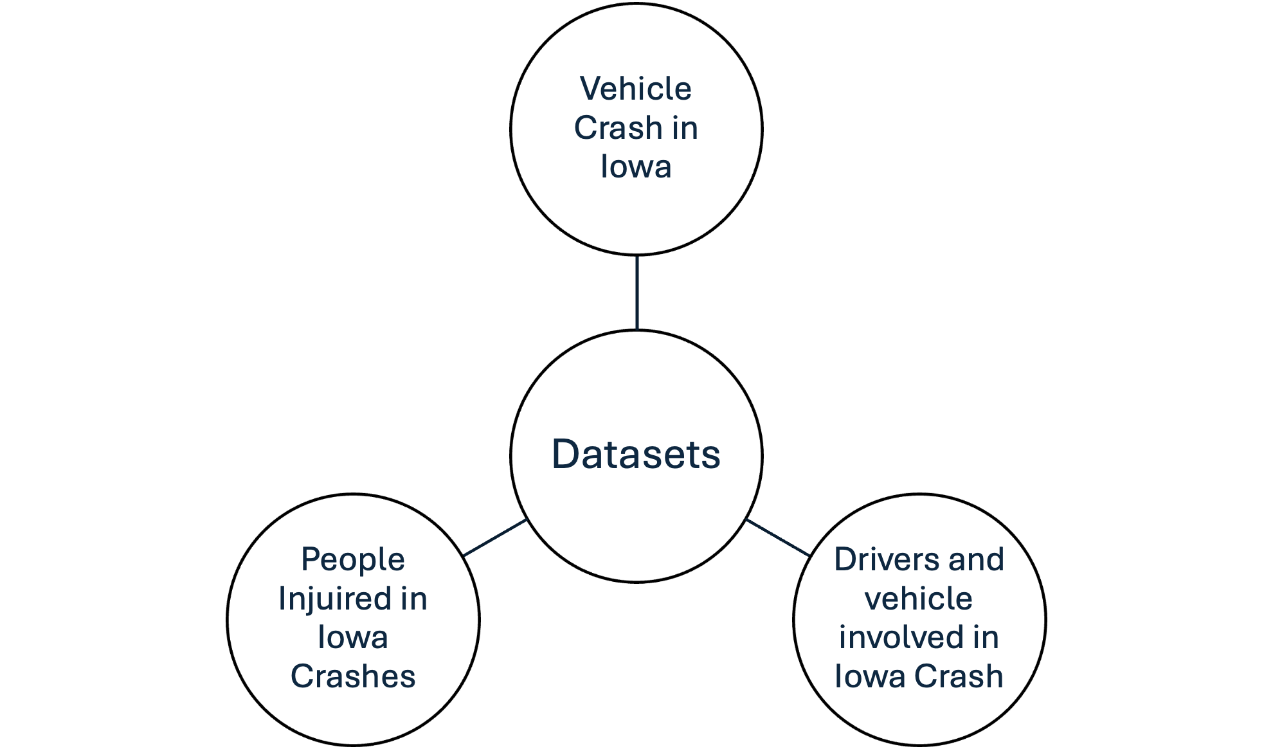
Project Description
Comprehensive Data Analysis:
Examine correlations between crash severity and factors like road conditions, weather patterns, alcohol involvement, and driver behavior.
Integrate the alcohol usage dataset to analyze its impact on crashes during specific times or events (e.g., holidays, sporting events).
Impact and Benefits:
Enhance road safety and reduce crash risks.
Influence transportation infrastructure and alcohol-related policy development.
Position Safe Routes Analytics as a key contributor to Iowa's safer future.
MIS 515: Big Data for Business
Notes:
"This project will focus on conducting analysis to explore the connections between crash severity and factors like road conditions, weather, alcohol use, and driver behavior. We will also integrate alcohol usage data to study its impact during specific events, such as holidays or sporting events. Our goal is to enhance road safety, influence policy decisions, and position Safe Routes Analytics as a key player in making Iowa’s roads safer for everyone."
To do this, we used three datasets from Iowa DOT’s website. Each dataset had useful information, and we combined them into one larger dataset using a unique ID called the Iowa DOT case number.

Slide 5
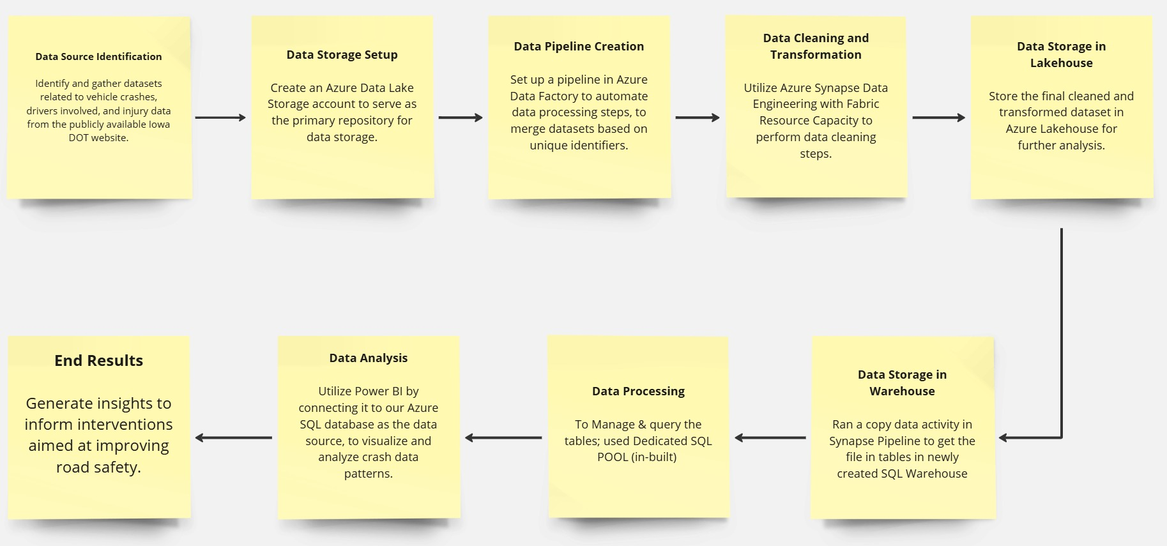
Process Flow
MIS 515: Big Data for Business
Notes:
The dataset contains a health and lifestyle survey information for each state. There are different questions in these surveys relating to individual health in those respective states. There were also different stratifications in these surveys on demographics such as gender, race, SES, and education level. The results are expressed as a percentage. There were multiple surveys results for each state. Preproccessing involved converting the percentages back to raw totals to make aggregation possible. We grouped by the question and the stratification to get this data. We also grouped by states to compare obesity levels and health related information.

Slide 6
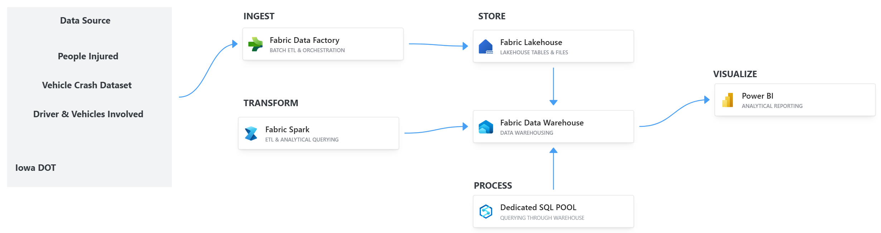
Architecture Diagram
MIS 515: Big Data for Business
Notes:
Create Azure Resource Group
We first created a resource group that included an Azure SQL DB, Blob storage account, and a Data Factory
Created SQL Server and wrote SQL code to define a table that would house the information from the Data Pipeline
Executed ETL in data factory
Set up 2 sinks: New folder in storage account and SQL table
Linked Tableau Cloud to Azure DB and created visualizations

Slide 7
Assumptions Made
Assumed all datasets followed the same collection methodology, enabling seamless merging and consistent analysis.
Ensured compatibility by using a unique identifier to link records accurately across datasets.
Assumed date and time fields were consistently formatted, allowing accurate time-based analysis and visualizations without extensive reformatting.
Assumed most records included sufficient details about drivers and vehicles, ensuring meaningful analysis with minimal missing data.
Preserved relationships between datasets during merging, preventing missing or duplicate records and ensuring accurate final analysis.
MIS 515: Big Data for Business
Notes:
We assumed all the datasets were collected in a similar way, which made it easier to merge them into one framework without worrying about differences in how the data was gathered.
We Used Iowa_DOT_Case_Number as a unique identifier for consistency.
We assumed all date and time fields were formatted consistently across the datasets. This made it easier to analyze crash trends over time without needing a lot of reformatting.
Most records appeared to have enough driver and vehicle details, like age, gender, and car make, to provide meaningful insights. This helped streamline data cleaning and made it easier to use these variables in analysis.
During merging, we made sure the relationships between datasets were maintained, especially using the case number to link records. This ensured the data stayed accurate and avoided issues like missing or duplicate entries, which could affect the analysis.

Slide 8
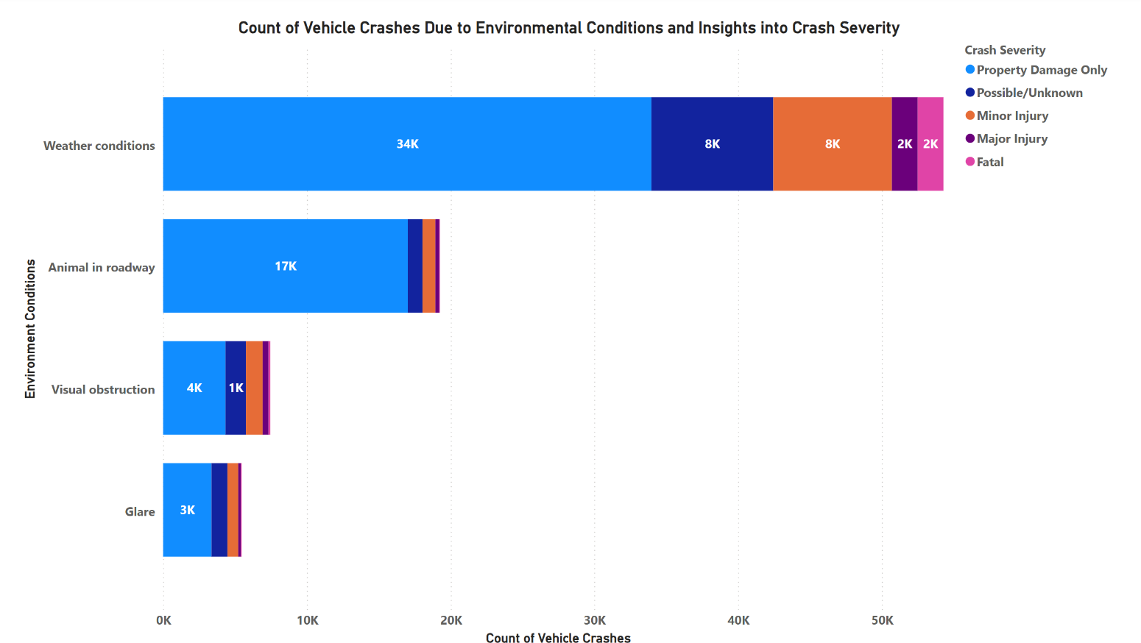
Visualizations
MIS 515: Big Data for Business
Notes:
This bar chart visualizes the relationship between crash severity and environmental conditions during the incidents.
Comparing crash severity levels across different environmental conditions helps identify patterns that show higher risks in certain situations.
This visualization helps policymakers and safety organizations decide on better road safety measures and road maintenance during bad weather.

Slide 9
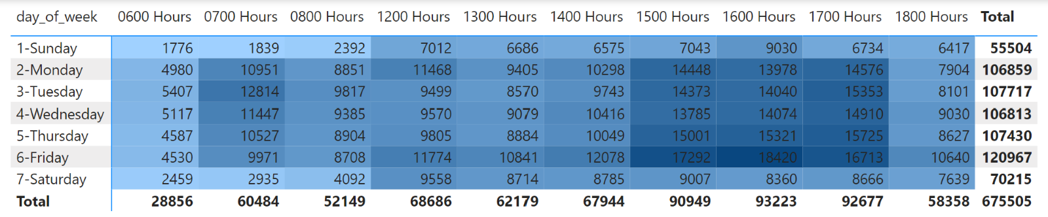
Visualizations
MIS 515: Big Data for Business
Notes:
This heat map shows when crashes are most likely to happen by displaying the distribution of crashes across different times of the day and days of the week. It gives a clear visual representation of high-risk periods.
By looking at this data, we can pinpoint the times when crashes are most frequent. This can help safety officials take targeted actions, like increasing law enforcement or running public awareness campaigns during these high-risk periods.
It also makes it easier to develop targeted strategies to improve traffic safety during those times.

Slide 10
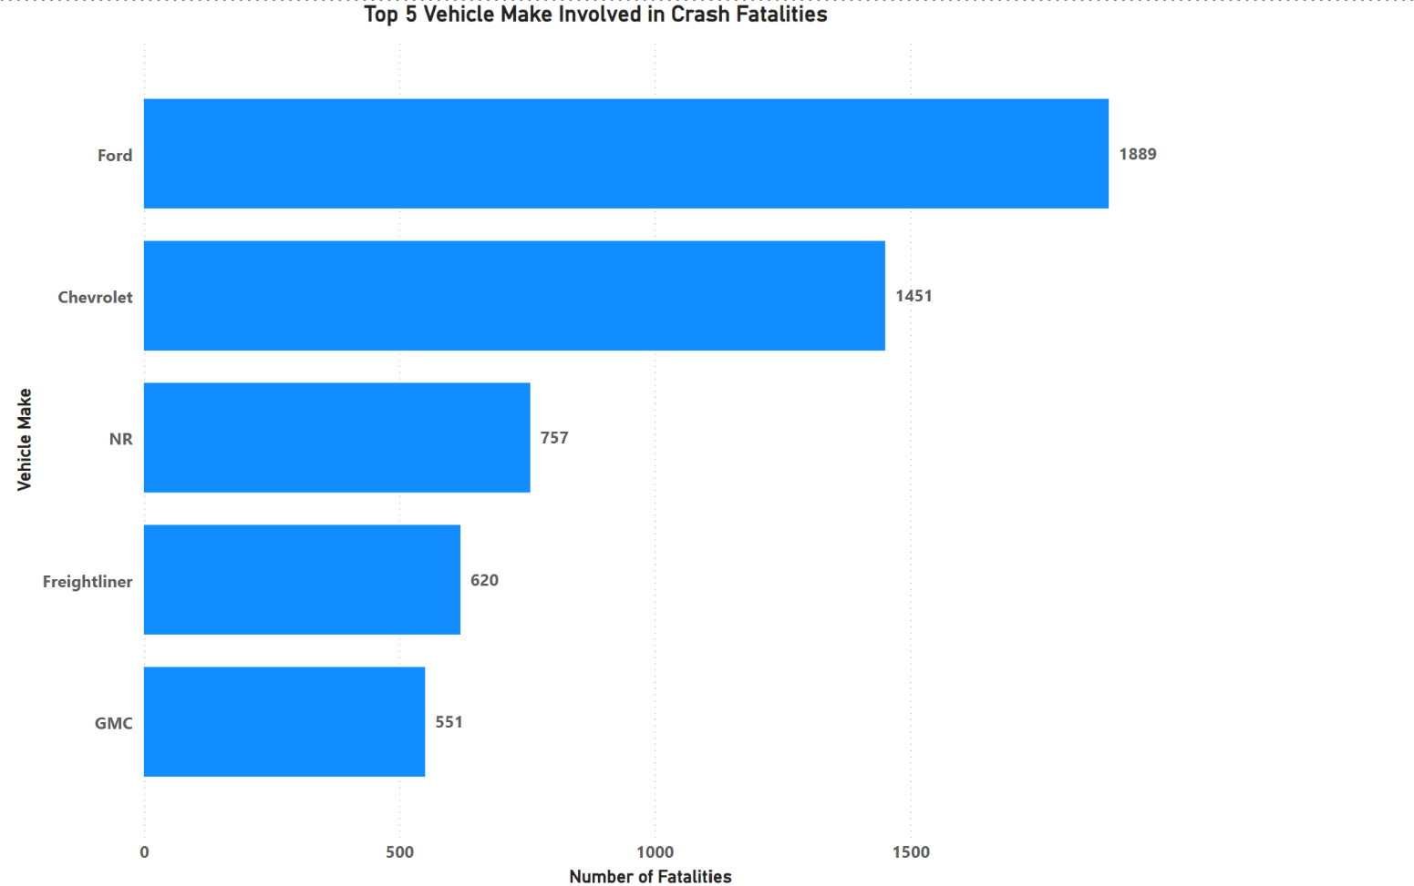
Visualizations
MIS 515: Big Data for Business

Slide 11
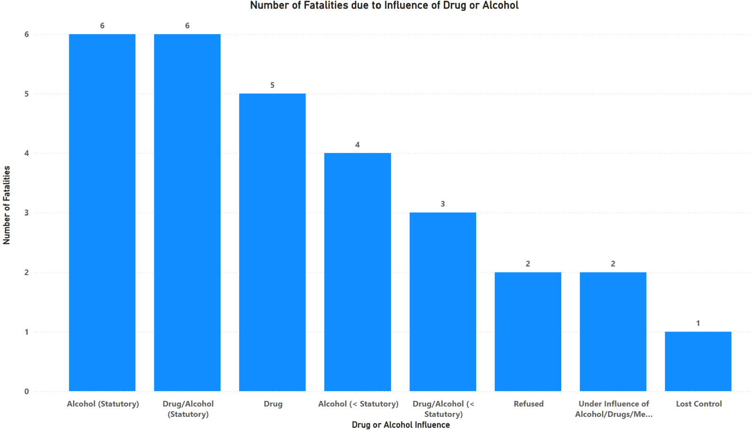
Visualizations
MIS 515: Big Data for Business
Notes:
Alcohol (statutory) - Blood Alcohol Concentration 0.08%

Slide 12
Recommendations
Enhance Road Safety Measures Based on Environmental Conditions
Targeted Traffic Enforcement During High-Risk Times
Collaborate with Vehicle Manufacturers for Improved Safety Features
Implement Educational Campaigns Focused on Impaired Driving
MIS 515: Big Data for Business
Notes:
Based on the bar chart, it’s clear that certain weather conditions lead to more severe crashes. Local governments should focus on better road maintenance, clearer signage, and improved lighting in areas affected by bad weather to help reduce crashes and save lives.
The heat map shows when crashes happen most often. Traffic enforcement can focus resources during these peak times, enforce laws like speed limits and DUIs, and educate drivers to promote safer driving and reduce crashes.
The tree map shows that some vehicle makes are linked to higher fatality rates. Regulators and manufacturers should work together to add advanced safety features like automatic braking and lane-keeping assistance to these vehicles, helping to reduce fatalities and make roads safer.

Slide 13

MIS 515: Big Data for Business
Notes:
Based on the bar chart, it’s clear that certain weather conditions lead to more severe crashes. Local governments should focus on better road maintenance, clearer signage, and improved lighting in areas affected by bad weather to help reduce crashes and save lives.
The heat map shows when crashes happen most often. Traffic enforcement can focus resources during these peak times, enforce laws like speed limits and DUIs, and educate drivers to promote safer driving and reduce crashes.
The tree map shows that some vehicle makes are linked to higher fatality rates. Regulators and manufacturers should work together to add advanced safety features like automatic braking and lane-keeping assistance to these vehicles, helping to reduce fatalities and make roads safer.

